Slide 1
Emotional Response Testing
Robert L. (Bob) Thomas, Director of User Experience

Slide 2
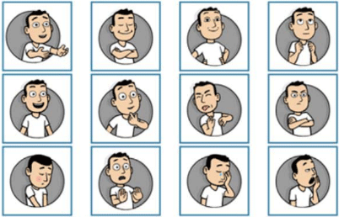
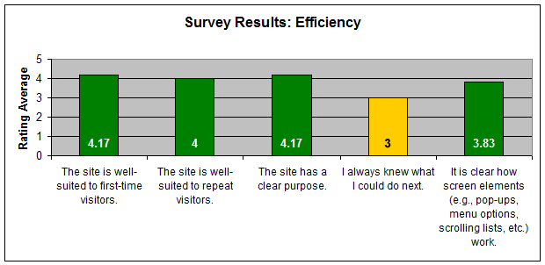
What Is Emotional Response Testing?
Definition
A collection of quantitative and qualitative usability research methods that enable you to assess users’ attitudes toward the aesthetics and visual appeal of a design or product
What It Is
A measure of how closely a design achieves a “desired” emotional response
What It Is *Not*
It is *not* a measure of how much people “like” a design or product
It is *not* a measure to decide which design is the “best”

Slide 3
Emotional Response Testing
Why It Is Important
First impressions of a design affect a product or application’s perceived usability and credibility

Slide 4
Methods
The Quick Test (Qualitative)
Show usability participants a design for anywhere up to 5 seconds, then remove that design. Participants recall their first impressions, then the moderator has the option to probe for meaning:
What was that page about?
Which elements stood out?
Can you describe them?
What is your overall reaction? Did you like it, not like it, or were neutral?
Advantages: it’s helpful for layout decisions, including imagery, emotional reaction, messaging, calls to action, and branding
Video: Quick Test

Slide 5
Methods

Slide 6
Methods

Slide 7
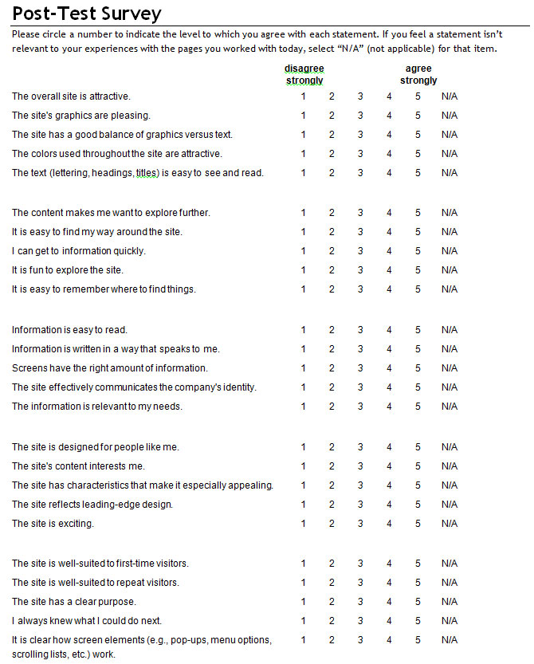
Methods
Questionnaires (Quantitative)
These are surveys usually given at the end of a task or usability session, measuring users’ satisfaction with a design, product, or application, that include questions relating to visual appeal and aesthetics
Example: System Usability Scale (SUS)

Slide 8
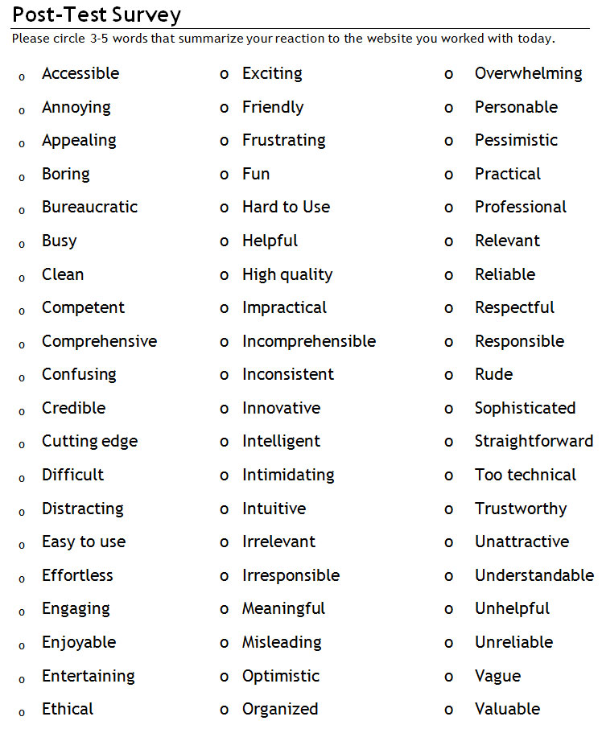
Methods
Product Reaction Survey (Quantitative & Qualitative)
Use existing marketing/brand materials to define one-word attributes of the brand
Example: “Responsible”
The team brainstorms to identify other key brand attributes, using the full list of Microsoft’s product reaction cards as a start
Identify 60 key brand attributes, using a 60%/40%, positive/negative attribute mix

Slide 9
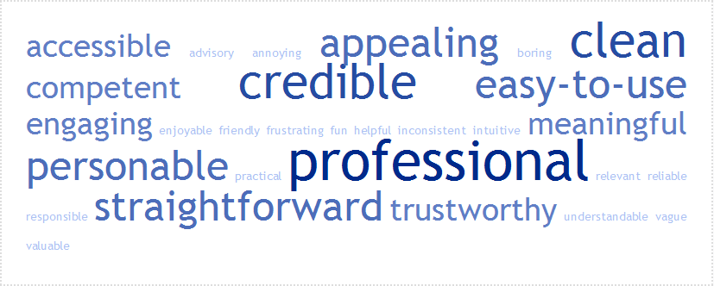
Methods
Product Reaction Survey (Quantitative & Qualitative)
You can also combine this quantitative method with qualitative comments
Example: After participants complete this survey, ask them, “Why did you circle these words?”
Results can be presented in the form of a tag cloud

Slide 10
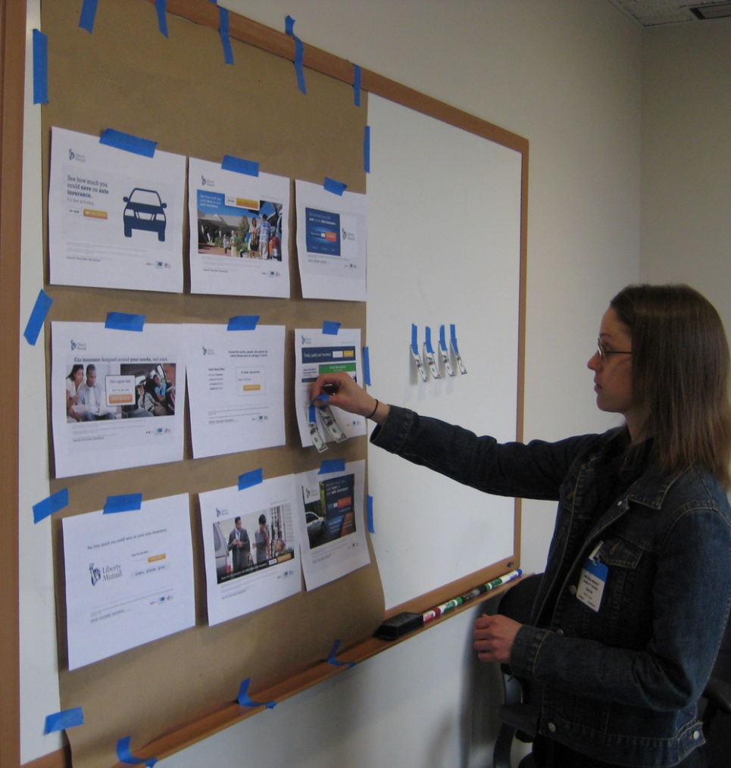
Methods
Interactive Exercises (Quantitative & Qualitative)
We ask participants to vote with Liberty dollars among a number of different designs, based on testing criteria
Example: “Please vote for those designs that most motivate you to get a quote.”
You can also combine this quantitative method with qualitative comments
Example: After participants complete this exercise, ask them, “Why did you place the dollars this way?”
Video: Voting for Dollars Exercise

Slide 11
Methods

Slide 12
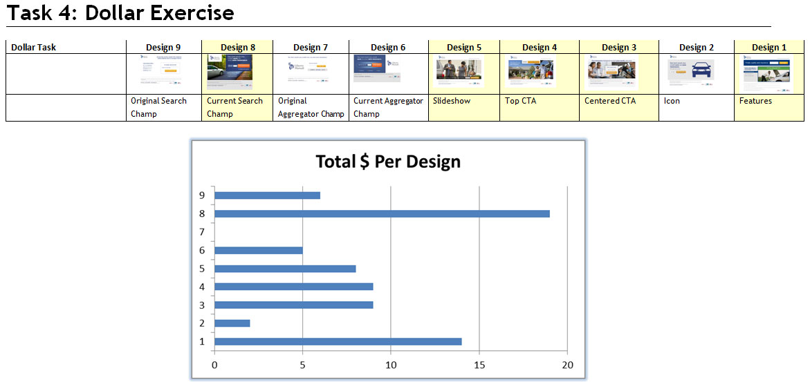
Methods

Slide 13
Methods
PrEmo (Quantitative)
Product Emotion Measurement: http://www.premo-online.com Dr. Pieter Desmet, Technical University of Delft
“How do the feelings expressed by the characters correspond with your own feelings towards the design?”
Video: PrEmo

Slide 14
Methods

Slide 15
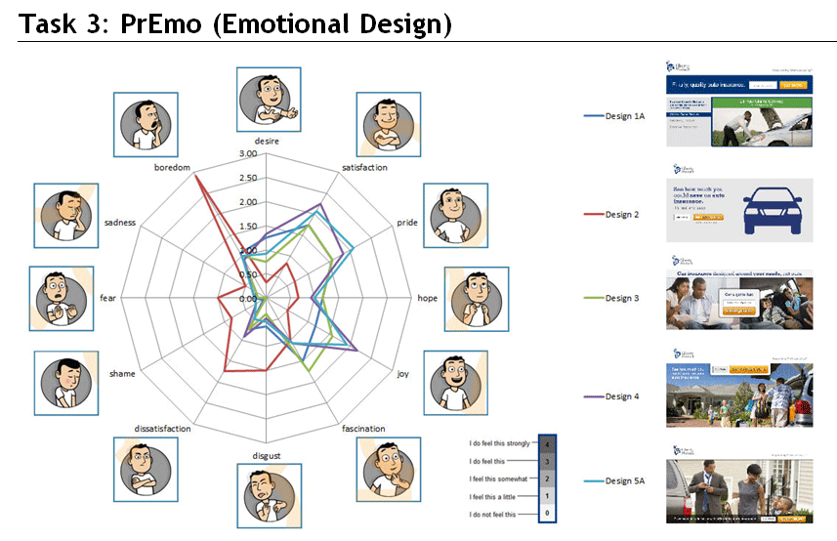
Methods

Slide 16
Lessons Learned
Quantitative and Qualitative
The mix of both is important. Quantitative results tell you what happened, and qualitative comments from users tell you why it happened
PrEmo
At first glance it looks complicated to complete, but users had few issues with it
While a few emotional responses (shame, sadness) seem not applicable, or a few character responses are hard to decipher (hope, fascination), the cartoon characters are easy for participants to figure out and provide solid quantitative data
Overall
It’s important to use the results as one input into the decision-making process, not to decide which design is “the best”

