Slide 1
Ethnographic Research: Home Gallery and Encircle
Bob Thomas Director of User Research
Notes:
Cover slide

Slide 2
Agenda
Executive Summary
Goals and Research Overview
Positives
Major Findings
Recap
Recommendations
Confidential – Not for Distribution

Slide 3
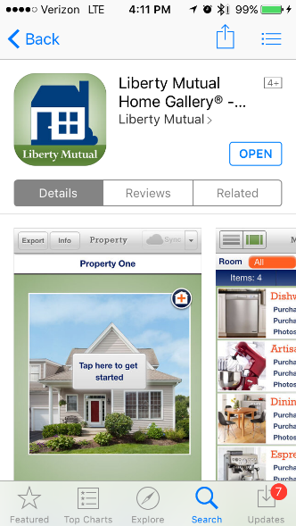
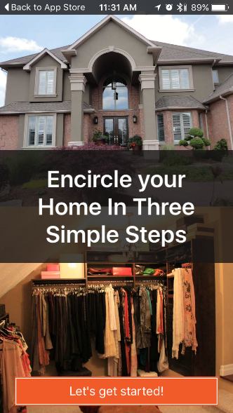
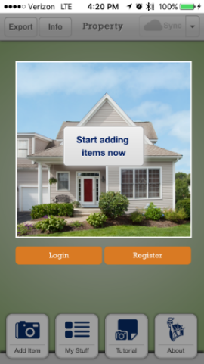
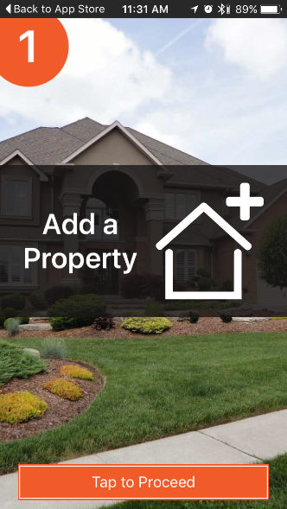
Executive Summary
Positives
Both apps look professional and thus have credibility among consumers
Once users figure out how to add items, including taking photos and entering details, they have an easier time using the apps
Confidential – Not for Distribution

Slide 4
Executive Summary
Major Findings, Home Gallery
After running 4 Home Gallery usability tests, it is our continued recommendation that the Home Gallery app needs to be simplified and streamlined.
There are too many barriers to entry, which will prevent widespread adoption. These barriers to entry include:
The sheer amount of time it takes a homeowner, condo owner, or renter to catalog all their personal property items of value (we can’t control this)
The amount of time it takes a user to find receipts or look up the value of items (again, we can’t control this)
An app name (Home Gallery) that is not intuitive to users. Our participants could not find the app in the App Store.
Step 1 in app: a 9-screen tutorial on first opening Home Gallery. A 9-screen tutorial makes the app seem complicated. Most iPhone and iPad users assume apps are intuitive and want start using them right away
Step 2 in app: a text-heavy intro screen that invites users to register or get started (without registering). Every participant wanted to try the app first before registering. The benefits of registering aren’t clear.
Step 3 in app: entering Property information. What is the value to the user? This is a user interace issue that generates confusion. We believe it is there for edge cases – for people with multiple properties.
Confidential – Not for Distribution

Slide 5
Agenda
Executive Summary
Goals and Research Overview
Positives
Major Findings
Recap
Recommendations
Confidential – Not for Distribution

Slide 6
Goals of Study
This usability study assessed the LM Home Gallery and Encircle applications for cataloging personal possessions or taking a home inventory.
Can users find the apps in the App Store?
What are the major usability problems that Home Gallery may have? That Encircle may have?
What are the barriers to use?
What are the usability issues?
In the comparison of ease of use of Home Gallery vs Encircle, what are the key differentiating factors/usability issues? How big of an impact are these issues to preventing adoption and use?
Confidential – Not for Distribution

Slide 7
Participant Demographics
8 Participants
College Degree and higher
Income: $65,000+
Has a current homeowners or renters policy and is the insurance decision maker
Primary Target
Recruit 5 iPad and 3 iPhone users who are experienced downloading and using productivity apps for the iPad and iPhone
Secondary Target
Recruit 4-6 home or condo owners and 2-4 renters. Recruit 2-3 LM customers, a mix of home/condo/renters.
No. of Participants | Age |  |  | Gender |  | Devices
 | 25-29 | 30-39 | 40-49 | Male | Female | iPad 2 | iPhone 6
8 | 3 | 3 | 2 | 5 | 3 | 4 | 4
Confidential – Not for Distribution

Slide 8
Final Likert Scales, Post-Task Questions: Home Gallery
Question: How likely or unlikely would you be to use an app such as Home Gallery in the future?
P1 | P2 | P3 | P4 | P5 | P6 | P7 | P8 | AVG
7 | 3 | 6 | 4 | 7 | 3 | 1 | 5 | 4.5
Not at All Likely | How likely or unlikely would you be to use such an app in the future? |  |  |  |  | Very Likely
1 | 2 | 3 | 4 | 5 | 6 | 7
4.5
Confidential – Not for Distribution

Slide 9
Final Likert Scales, Post-Task Questions: Encircle
Question: How likely or unlikely would you be to use an app such as Encircle in the future?
P1 | P2 | P3 | P4 | P5 | P6 | P7 | P8 | AVG
7 | 2 | 6 | 4 | 7 | 4 | 6 | 5 | 5.13
Not at All Likely | How likely or unlikely would you be to use such an app in the future? |  |  |  |  | Very Likely
1 | 2 | 3 | 4 | 5 | 6 | 7
5.13
Confidential – Not for Distribution

Slide 10
Agenda
Executive Summary
Goals and Research Overview
Positives
Major Findings
Recap
Recommendations
Confidential – Not for Distribution

Slide 11
Positives
Most participants recognized the value of the Home Gallery app
“Trustworthy, because of the name, Liberty Mutual. This concept is very appealing to me. P4
Made [P5] think that this is something she should be doing. P5
Now he is thinking that he should have a catalog like this. P8
More participants preferred Home Gallery to Encircle
5 participants preferred the Home Gallery app
Export feature
If participants got to it, they really liked the ability to export their lists.
Confidential – Not for Distribution

Slide 12
Positives, Home Gallery
Confidential – Not for Distribution

Slide 13
Agenda
Executive Summary
Goals and Research Overview
Positives
Major Findings
Recap
Recommendations
Confidential – Not for Distribution

Slide 14
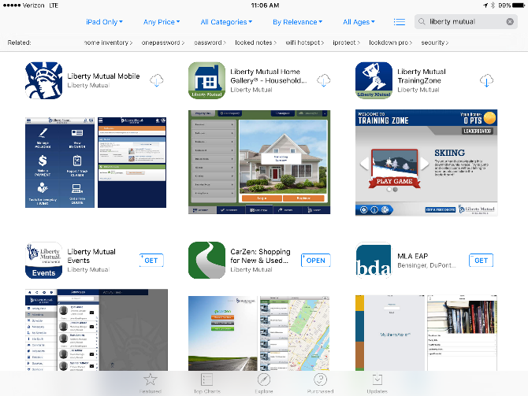
Major Findings: Barriers to Entry | Download Process
All participants struggled to find Home Gallery in the app store without moderator assistance.
Search terms participants used:
“Inventory”
“Personal possessions app”
“Insurance app for personal possessions”
“List for personal possessions, valuables”
“Inventory for homeowners”
“My Inventory Manager”
“Moving, organizing, and inventory”
“Home inventory, moving, collection”
“Create a list”
“Store list”
Confidential – Not for Distribution

Slide 15
Major Findings: Barriers to Entry | App Value
Almost all participants stated that the name “Home Gallery” does not connect with a “personal inventory” of possessions.
“The name “Home Gallery” makes me think of things to buy, furnishings or paintings.” P5
“This kind of makes it sounds like I’m designing a home – more related to HGTV than an insurance company.” P8
“’Home Gallery’ doesn’t make sense to me – it’s more like photographs than something that would help me with this task.” P7
Recommendation
Confidential – Not for Distribution

Slide 16
Major Findings: Barriers to Entry | User Type
Participants expressed confusion about Home Gallery’s user type
Several participants said they would need to be a Liberty Mutual customer to use this app
Some participants voiced concerns about providing an insurance company with their personal info, thinking they would get calls
P7 “I'd want to be able to use it independent of whether I was with Liberty Mutual or not, and I'd want to make sure it was secure.”
Recommendation
Confidential – Not for Distribution

Slide 17
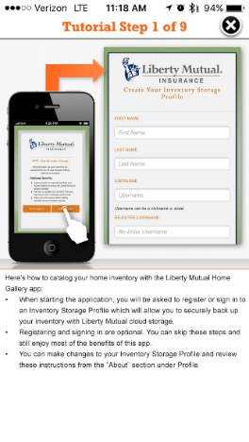
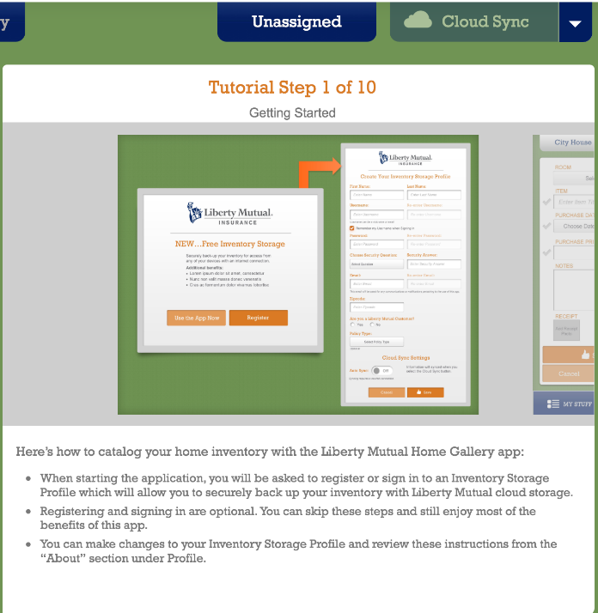
Major Findings: Ease of Use | Tutorial
Lengthy, static content functions as a manual, not a tutorial, for users
Almost all participants skipped the tutorial on both iPhone and iPad
Participants who did view the tutorial scanned the first few screens, not the full 9 screens (iPhone) or 10 screens (iPad)
Many stated that they expect apps to be intuitive enough to use without looking at a tutorial
P7 “I usually don't go through tutorials when I start an app. I don't want to be bothered. I want to jump right in.”
Recommendation
Confidential – Not for Distribution

Slide 18
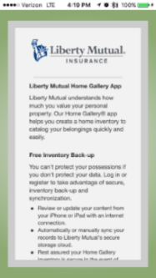
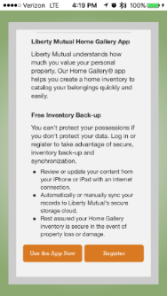
Major Findings | Access to App
Home Gallery allows users to try without registering, which they liked. However, following that information, most participants showed strong negative reaction to the opening screen.
Most participants thought they could try the app without creating a username, but this screen seems contradictory:
P7 “The first screen is causing confusion, because it shows you "Start adding items now," Login button, and Register button.”
Confidential – Not for Distribution

Slide 19
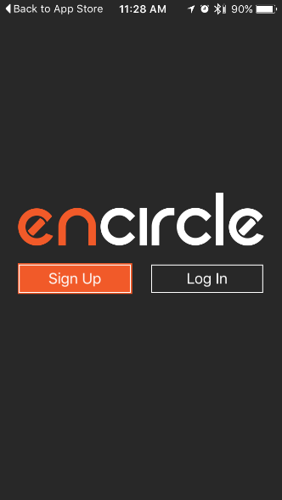
Major Findings: Barriers to Entry | Log In/Register/Start
All participants chose not to register.
The value in registering wasn’t explained up to this point, before or after, of using the app.
Most participants who used Encircle would exit if forced to sign in/register
All participants stated or intimated that they would only use the app if they could try it before registering.
P2 “I would not do this unless it was my own insurance company. I would close out and find something else. I'm not a fan and the second you open it up it wants your name , address, phone…I'm tired of the spam-I would just close it out.”
P3 “I usually only get free apps-at least to start, bc if I download and don't like, I can just delete and look for a different one.”
Recommendation
Confidential – Not for Distribution

Slide 20
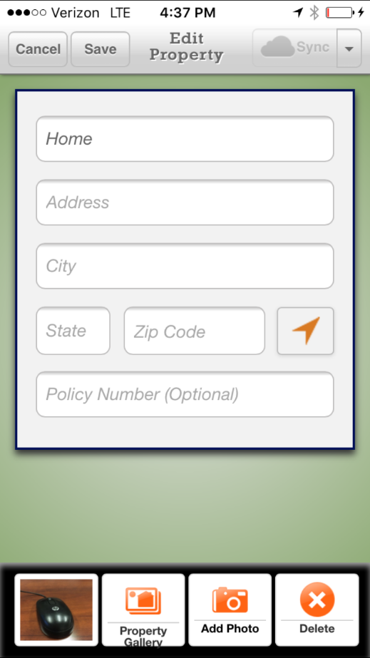
Major Findings| Access to App
After viewing the tutorial, participants were ready to get started adding their items.
Participants had trouble knowing what exactly they were taking photos of
Some took photos of their items when they should have taken photos of rooms
She thinks she is adding items but she is taking multiple photos of her property. [P5]
They were then confused when they could not find the pictures of their items
Confidential – Not for Distribution

Slide 21
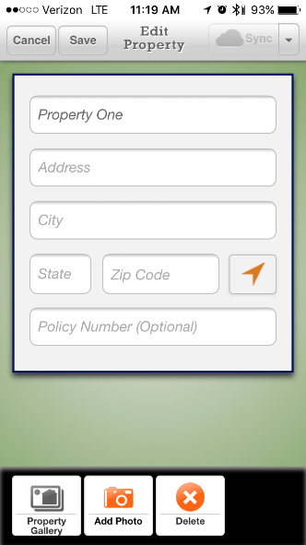
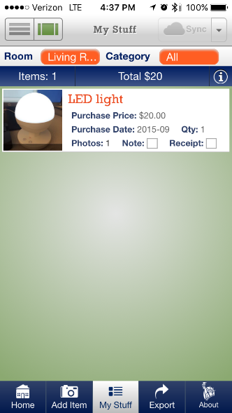
Major Findings | Wayfinding
Navigation, Organization, Wayfinding
It was difficult for Ps to know where they were in the app and where they could go next.
Several participants were confused as to whether they were working with a property, room, or item
Several P’s took pictures in the room or property level, thinking that they were taking pictures of items.
Later on, they would wonder where these photos were, and assumed they were lost
P5 [tapping “Add Item”] “This is not working for some reason. Is this supposed to work?”
Confidential – Not for Distribution

Slide 22
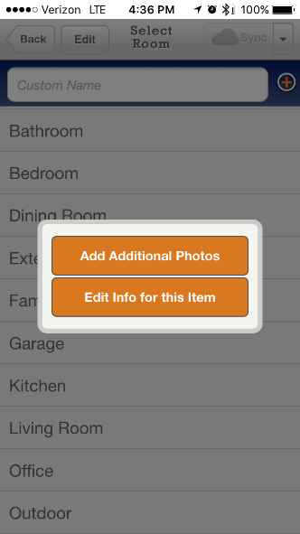
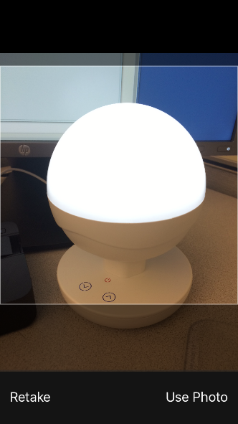
Major Findings | Conceptual vs. Mental Models
Participants wanted more flexibility in how they could add in their item photos
Several Ps would group items by category, rather than by room
Participants suggested these categories:
Jewelry
Electronics
Clothing
Furniture
Confidential – Not for Distribution

Slide 23
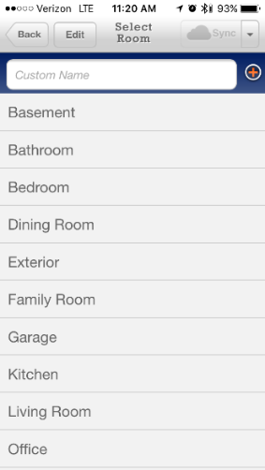
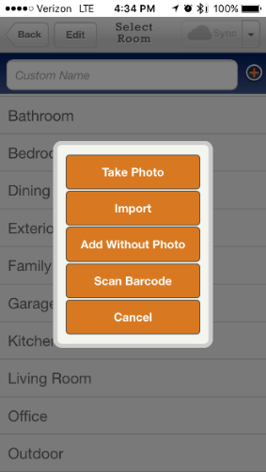
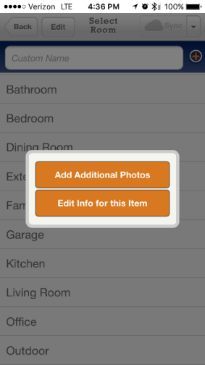
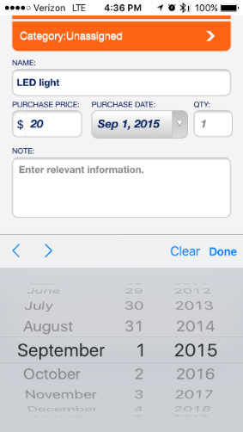
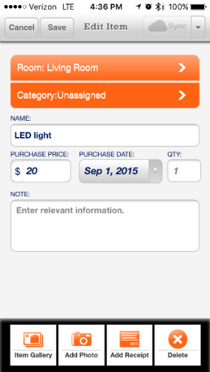
Conceptual Model
Participants found the process lengthy and prescriptive.
They were forced into a method of adding their property first, then categorization, then adding item details.
P’s use demonstrated inflexibility in the add item process.
P1 theorized the ideal process: “Would try to make it as simple as possible.. would list things in bedroom, kitchen...Would organize by room.”
Confidential – Not for Distribution

Slide 24
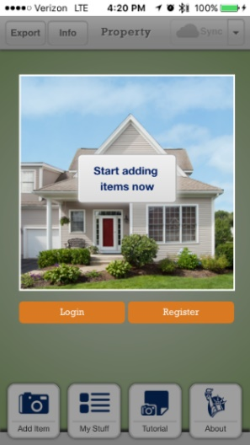
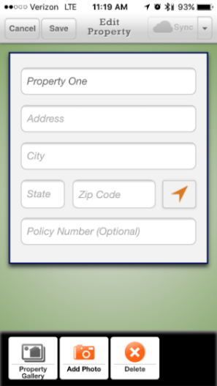
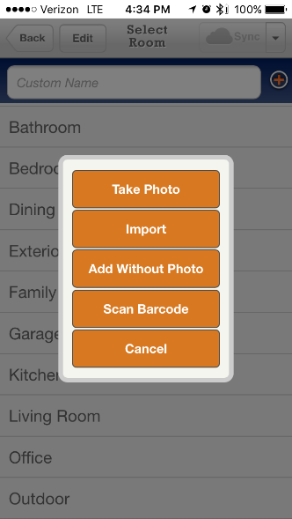
Mental Model
Participants had unique expectations of how the “Add Item” process should flow:
Method #1: Add item by item
Method #2: Bulk take photos or notes of all items, add details later.
P1 She said she would add all pics first, then sit down and type info in.
P2 “I would do my [item] category… Not by room.”
P4 “I think this app would walk me through the process. You might go room by room. And it would give you a checklist for each room, like china, antique chair, etc. for the dining room.”
Confidential – Not for Distribution

Slide 25
Agenda
Executive Summary
Goals and Research Overview
Positives
Major Findings
Recap
Recommendations
Confidential – Not for Distribution

Slide 26
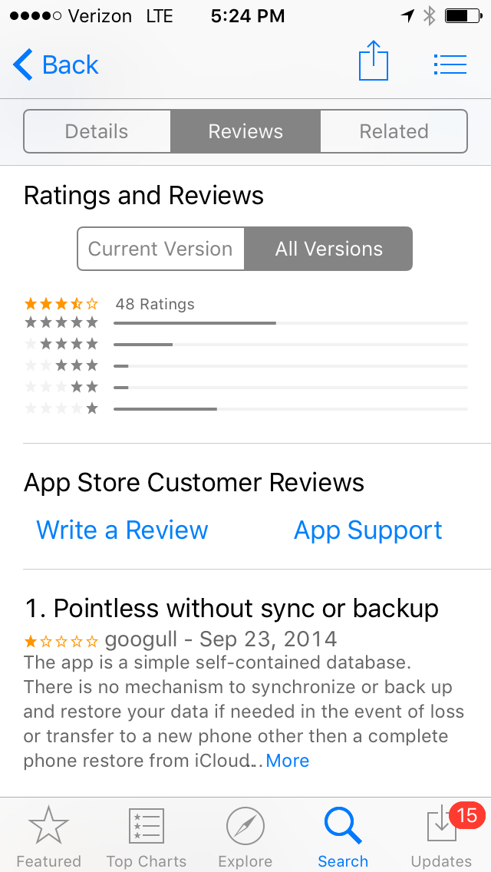
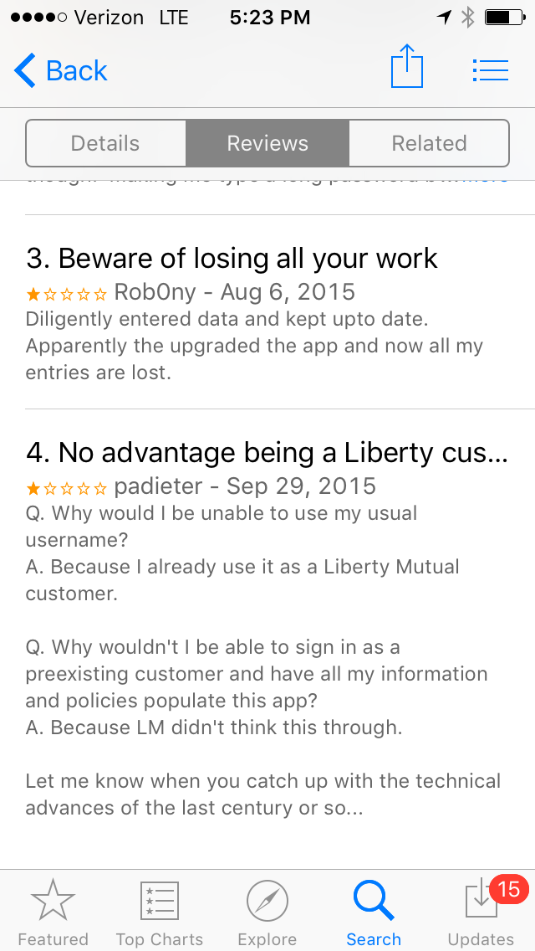
Recap
Major Findings
After running 4 Home Gallery usability tests, it is our continued recommendation that the Home Gallery app needs to be simplified and streamlined
Otherwise, the user base will continue to erode
Confidential – Not for Distribution

Slide 27
Recap
Major Findings
There are too many barriers to entry, which will prevent widespread adoption. These barriers to entry include:
The sheer amount of time it takes a homeowner, condo owner, or renter to catalog all their personal property items of value
“You want me to take a pic of my electric mixer? I would not do that… My biggest gripe with both apps is they are too time consuming. I don't have the time for anything like this.” [P2]
The amount of time it takes a user to find receipts or look up the value of items
“Purchase date: exact date is…. I would know year, but not the exact day and month – this makes you pick the exact date. Without receipt, I wouldn't know that information. Date would be important in terms of depreciation and things like that.” [P3]
Confidential – Not for Distribution

Slide 28
Recap
Major Findings
The app name (Home Gallery) is not intuitive to users. None of our participants could find the app in the App Store when given Task 1.
“‘Home Gallery’ doesn’t make sense to me. It’s more like photographs than something that would help me with this task.” [P7]
Our app has only 4 reviews, with an average of 1.75 stars. Participants looked at the reviews and considered them important. Many participants commented on the low number of reviews; they concentrated on the negative reviews.
“It only has 4 reviews of 1-2 stars. So I would probably pass on it.” [P7]
Confidential – Not for Distribution

Slide 29
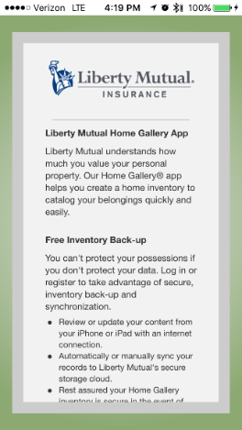
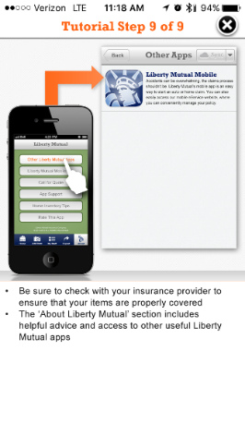
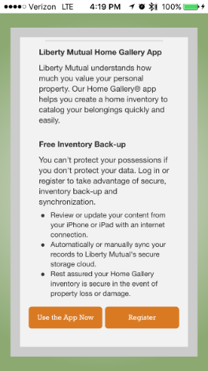
Recap
Major Findings
Step 1 in app: a 9-screen tutorial on first opening Home Gallery. A 9-screen tutorial makes the app seem complicated. Most iPhone and iPad users assume apps are intuitive and want to get started using them right away
Step 2 in app: a text-heavy intro screen that invites users to register or get started (without registering). Every participant wanted to try the app first before registering. The benefits of registering aren’t clear
Step 3 in app: entering Property information. What is the value of entering Property information to the user? This issue generates confusion. We believe it is there for edge cases – users with multiple properties
Confidential – Not for Distribution

Slide 30
Agenda
Executive Summary
Goals and Research Overview
Positives
Major Findings
Recap
Recommendations
Confidential – Not for Distribution

Slide 31
Recommendations: Overview
Consider incorporating the following:
Make the process less time consuming for users. Allow them to add items right away
Have fewer screens from opening the app to adding in items. Get users to the activity of value to them as quickly as possible
Condense the tutorial to one screen that is interactive
Guide users through the opening steps
Offer flexibility with how users can add information or pictures
Consider changing when the log in/sign up screen is shown
Make it more clear to users what the benefits of registering are, right from the start
Confidential – Not for Distribution

Slide 32
Recommendation: Barriers to Entry | Download Process
The key factors for a user to download an app are as follows:
App Content & Images
User Reviews
Star Rating
Recent Updates
Confidential – Not for Distribution

Slide 33
Recommendation : Barriers to Entry | Reviews
Positive reviews will lead more users to download and try the app.
Enhance marketing in other Liberty Mutual channels, which will lead more users to leave a review
Confidential – Not for Distribution

Slide 34
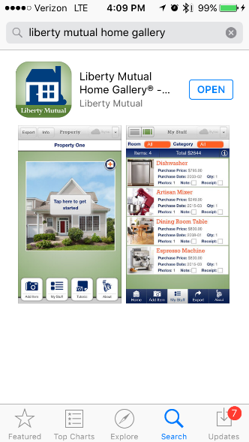
Recommendation: Barriers to Entry | App Store
Improve the app description in the App Store!
Improve the description of the app, as the name “Home Gallery” does not resonate with users
Cement the app value in user’s mind
Reiterate the security of the app
Back to previous linked screen
Confidential – Not for Distribution

Slide 35
Recommendation: Barriers to Entry | User Type
Clearly identify users and make it known that both customers and non-customers of Liberty Mutual are able to use this app and can find a benefit in doing so
Back to previous linked screen
Confidential – Not for Distribution

Slide 36
Recommendation: Barriers to Entry | App Value
Clearly describe the benefits of the app so users can understand these benefits while they are browsing in the App Store
Move this information from within the app, to a public space, to effectively answer the user’s questions before they ask:
What is this app?
What is the value of the app?
Confidential – Not for Distribution

Slide 37
Recommendation : Barriers to Entry| Login/Register/Start
All participants chose not to register, opting to “try before buy”
This is a big benefit of Home Gallery
Simplify this screen, so that participants don’t feel misled or confused.
Get participants to the activity as soon as possible!
Back to previous linked screen
Confidential – Not for Distribution

Slide 38
Recommendation: Ease of Use | Tutorial
Create a brief, succinct, informative tutorial.
Choose dynamic presentation like other apps: video, interactive, overlay
Keep tutorial content to one page
Back to previous linked screen
Confidential – Not for Distribution

